Slide 1
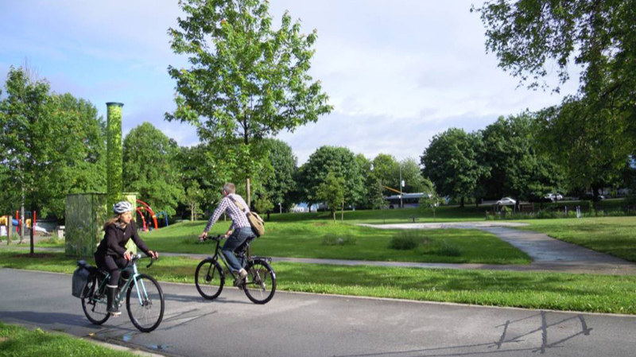
Healthy Cycling – Healthy Life!
21 Feb 2020
This Photo by Unknown author is licensed under CC BY-SA-NC.

Slide 2
Agenda
Introduction to the team
Bicycle in Barcelona
USP & value proposition
Available data
Solution
Project plan
Challenge

Slide 3

Introduction to the team
Global Head of Visualization Manager – Ketevan Kakabadze
Bachelor in Business Administrations – Ms in Economics – Ms in Big Data Solutions
Data Analyst Intern – Alejandro Schwartz
Bachelor in Actuarial Science – MBA – Ms in Big Data Solutions
CEO – Marcel Rosenberger
Bachelor in Business Administration -
Ms in Big Data Solution

Slide 4

Introduction to the topic
General overview about climate change
Barcelona City Council has declared the Climate Emergency, with an action plan and a budget of 563 million euros to implement a hundred different measures. The goal is to halve greenhouse-gas emissions by 2030 in comparison to levels recorded in 1992, and to cut CO2 emissions by two million tonnes.
The Climate Plan specifies the goals […] with the target of being a carbon neutral city by 2050.
The plan has 6 pillars of action:
Mobility
Urban Planning
Energy
Economy
Food
Consumption and waste
Notes:
Mention the restriction for cars in the urban center (weekends during specific times)

Slide 5
Introduction to the topic
General overview about climate change
Barcelona City Council has declared the Climate Emergency, with an action plan and a budget of 563 million euros to implement a hundred different measures. The goal is to halve greenhouse-gas emissions by 2030 in comparison to levels recorded in 1992, and to cut CO2 emissions by two million tonnes.
The Climate Plan specifies the goals […] with the target of being a carbon neutral city by 2050.
The plan has 6 pillars of action:
Mobility
Urban Planning
Energy
Economy
Food
Consumption and waste
Notes:
Mention the restriction for cars in the urban center (weekends during specific times)

Slide 6
Introduction to the topic
Biking in the city of Barcelona
+100K subscribers (+10% Annual Growth)
+1MM monthly uses
+44K labour day uses
13mins avg. Way
46% women/54% men
+35% get the bike through the app
Mostly 25-34 yrs. old
184 kilometres of bike paths
By 2020 7K bikes – with 2k electric and 500 stations (424 atm)
NPS 6.9
89% of Barcelona citizens has a bike path at least 300 meters away from home

Slide 7
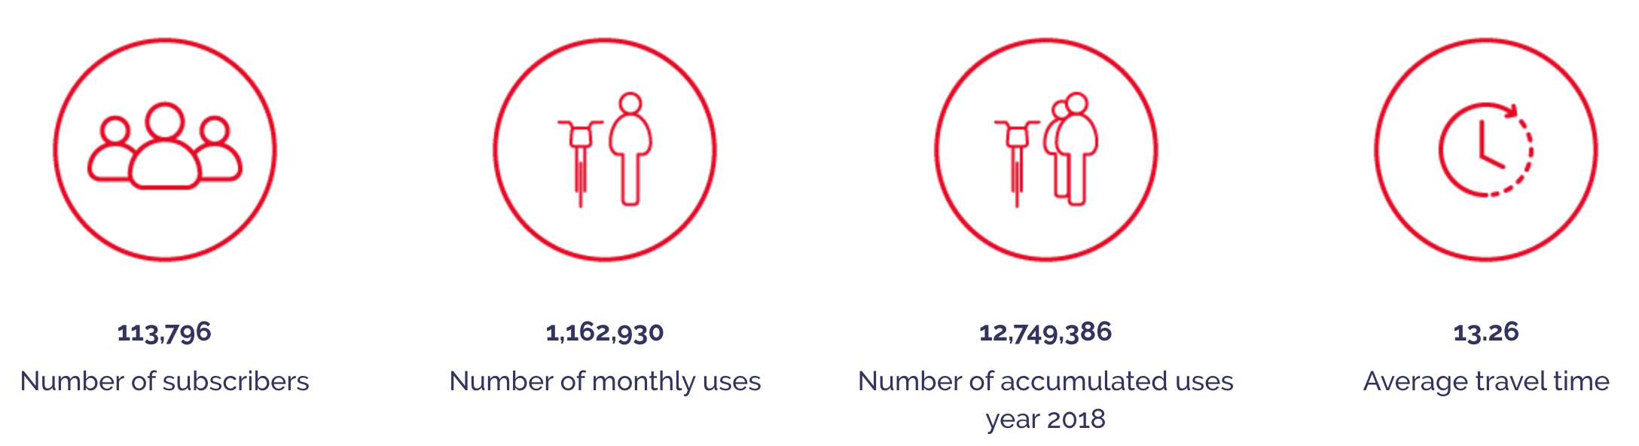
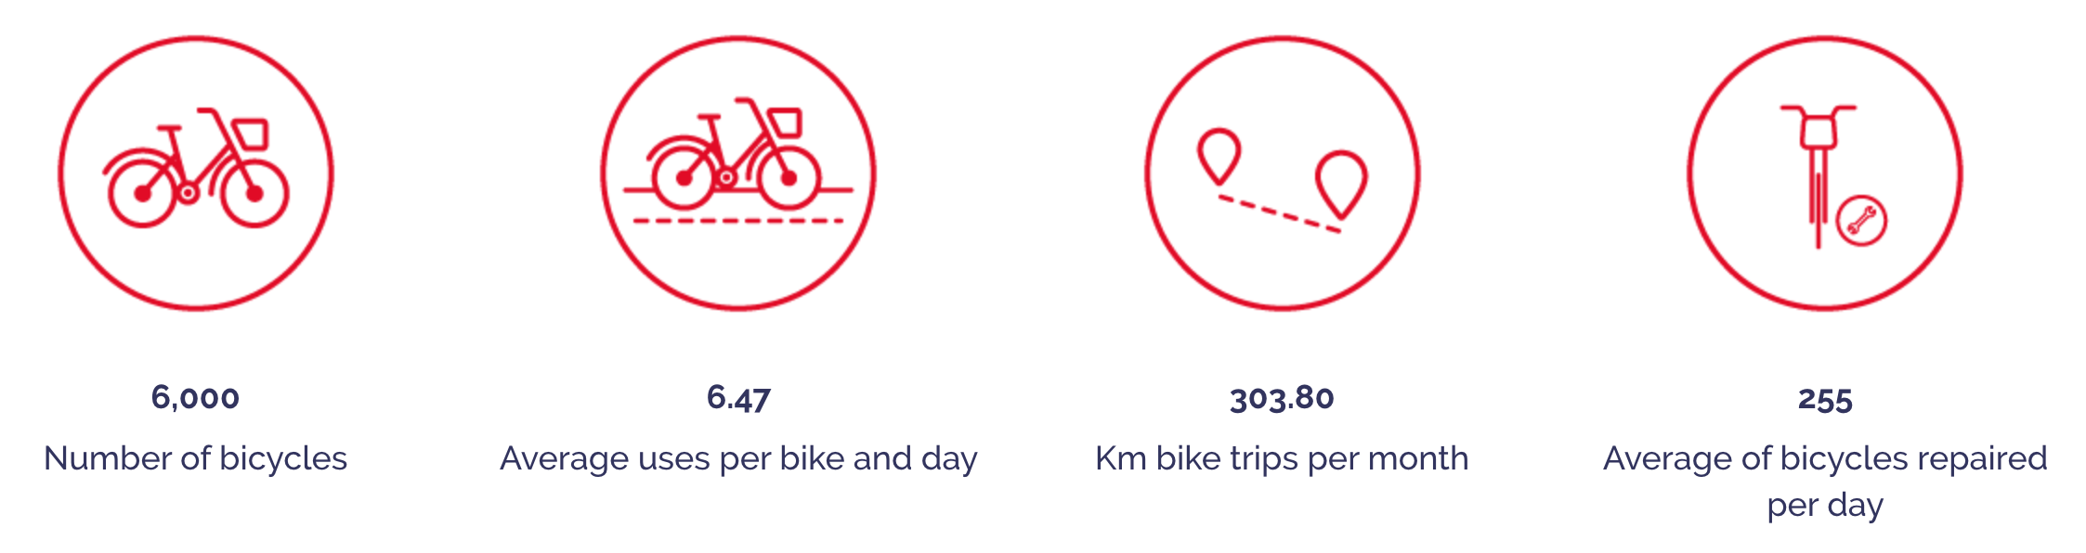
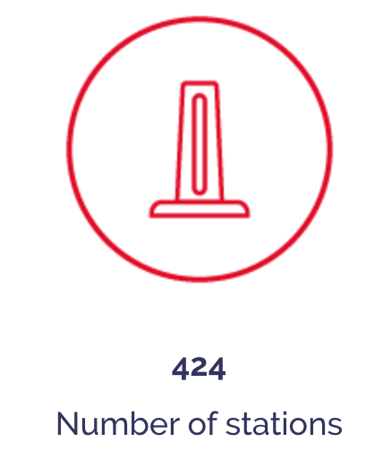
Bicing in Barcelona
And more facts:
184 kilometres of bike paths
+35% get the bike through the app
Mostly 25-34 years old
+44K labour day uses
By 2020 7K bikes – with 2K electric and 500 stations
Net promote score 6.9
89% of Barcelona citizens has a bike path at least 300 meters away from home

Slide 8
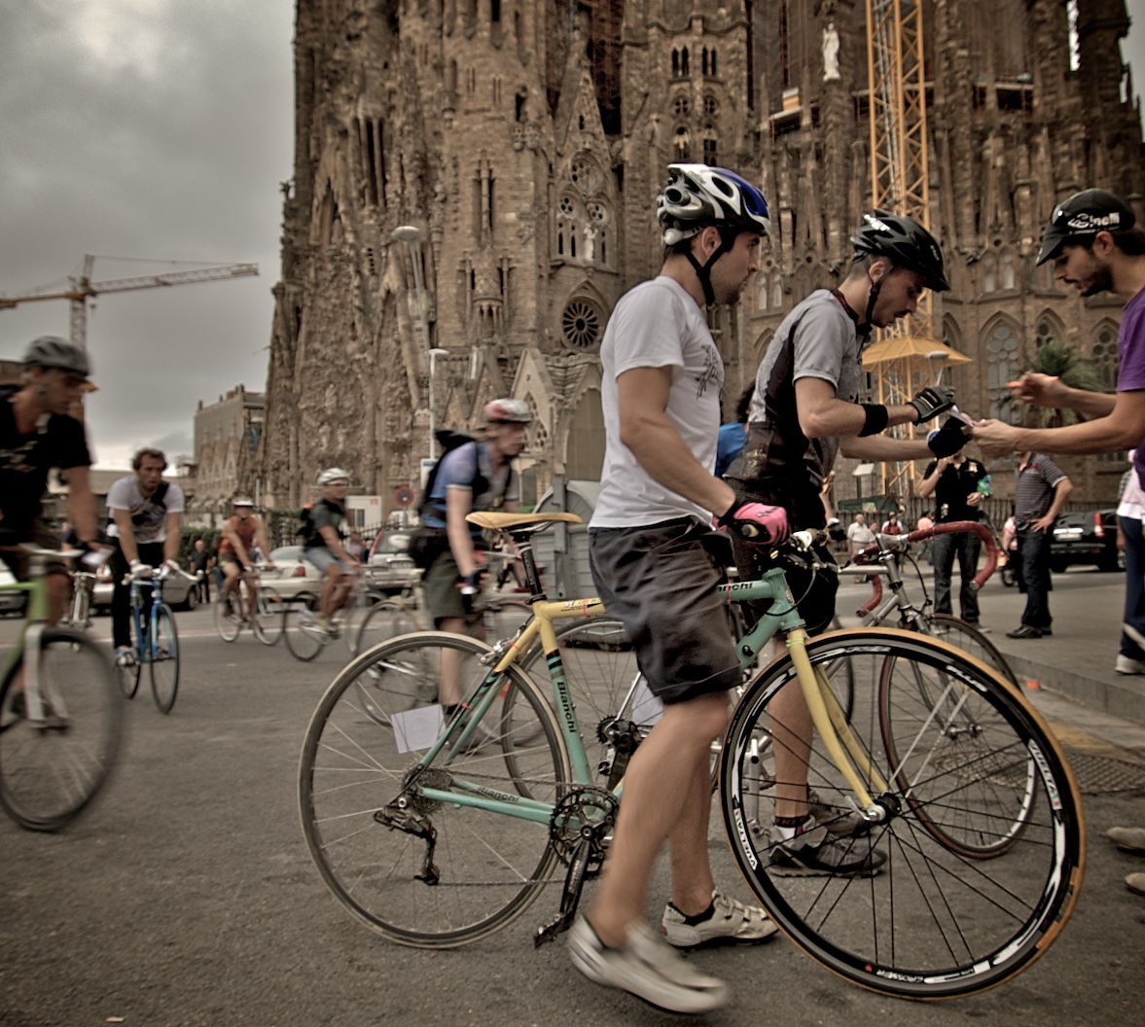
Challenge
"Creating a solution for bikers to find the healthiest and safest route"
Who? - Bikers in the city of Barcelona
What? - Route optimization considering different features in a tradeoff scenario
Why? - Improving bike riding experience towards healthier and safer routes in the city and supporting Barcelona's climate emergency plan to reduce pollution by encourage more biking
This Photo by Unknown author is licensed under CC BY-SA.

Slide 9
Bicycle in Barcelona
Pains:
- Bike paths often go along streets with lots of traffic
- Unsafe and polluted
- Bike paths often lead to a dead end without signs for further directions
- Traffics light intervals are rather set for cars than bikers
- Road conditions are not the best
Gains:
- Wide bike network
- Easly accessible (money and distance)
- Healthy exercise
- Environment friendly
- Fastest way to get around

Slide 10
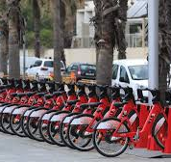
USP & value proposition
Support existing bikers and gain new ones through additional features
Contributing to a healthier and safer cycle route by choosing unpolluted, less frequented routes by cars and in better conditions
Creating advantages to increase the usage of biking in cities
Other maps are suggesting routes but without information about air pollution and noise

Slide 11
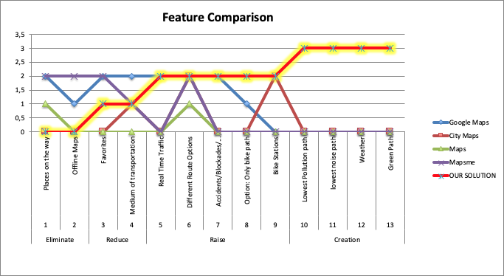
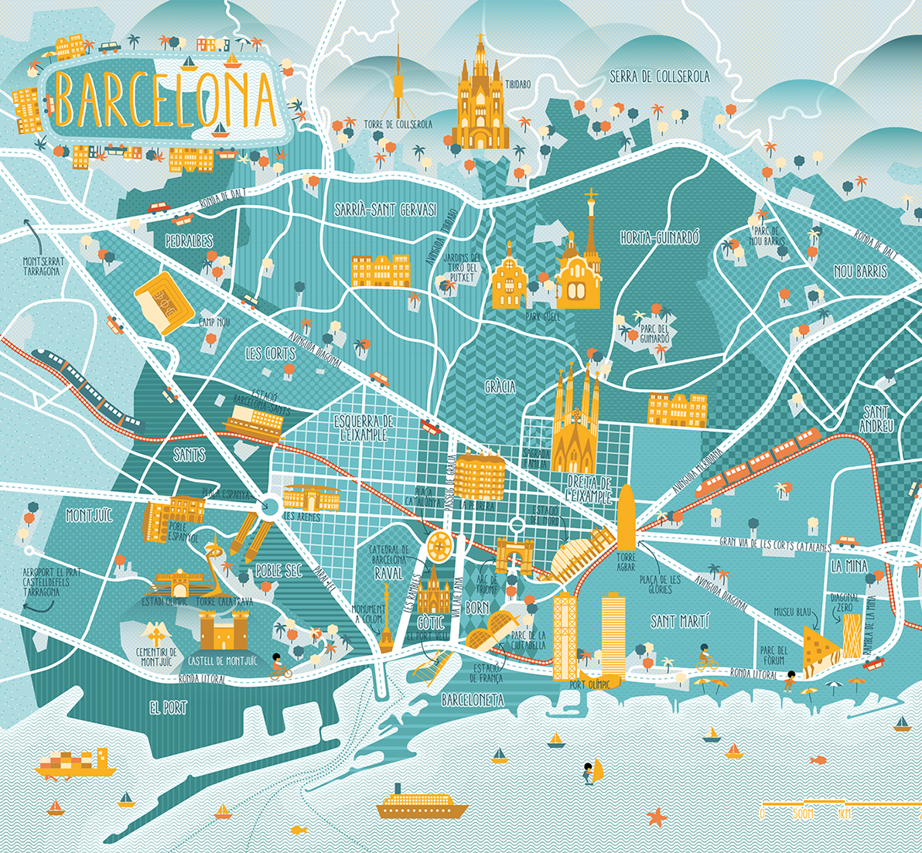
USP & value proposition

Slide 12
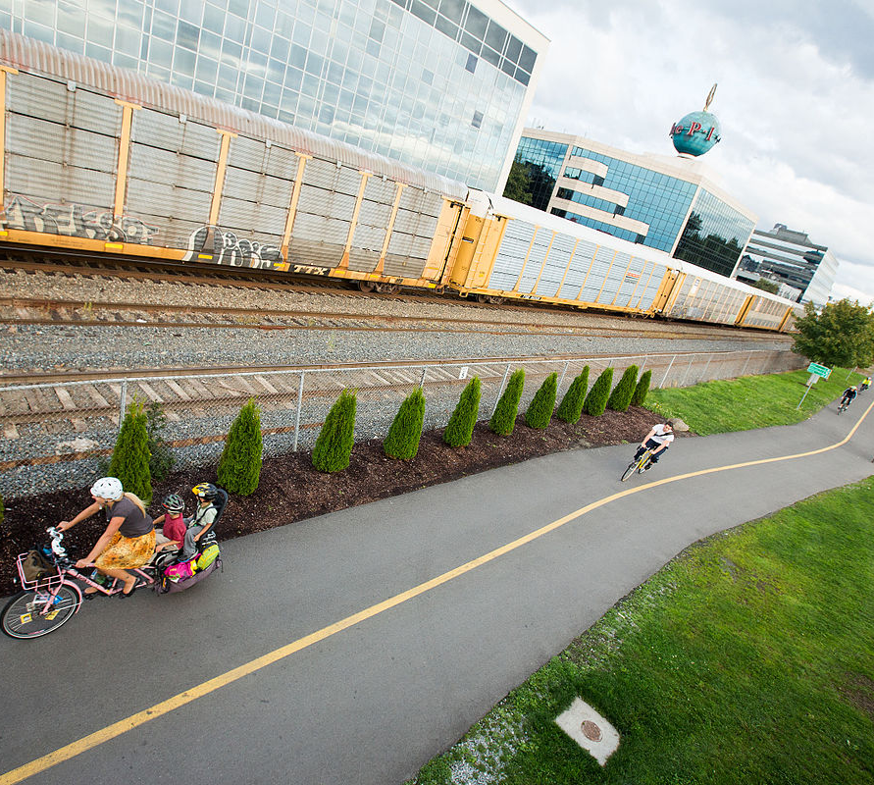
Short & Long Term - Scalability
Short term
Recommend alternative unpolluted, less noisy and shady routes
Long term:
Help bike planners and city governments to optimize the bike paths and station locations.
Scale recommendations for others last mile mobility solutions.
Help implementing routes in other cities less developed in terms of bike planning
This Photo by Unknown author is licensed under CC BY-SA.

Slide 13
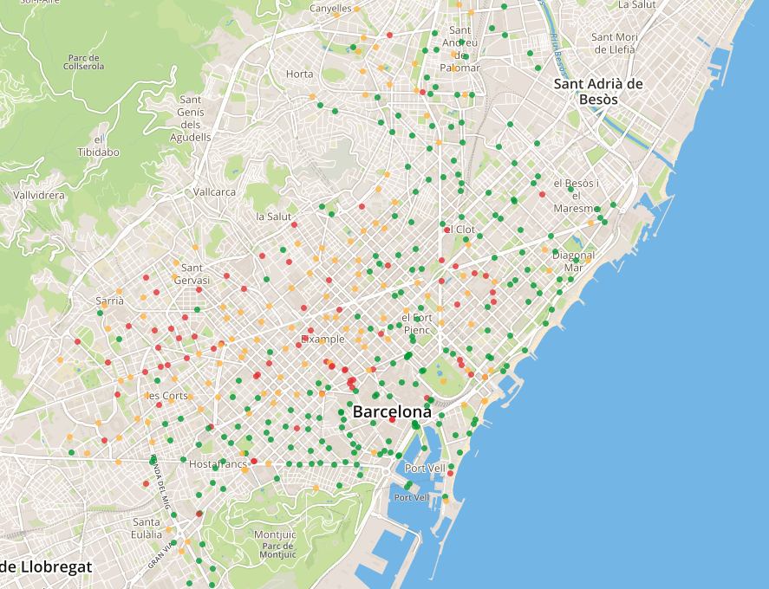
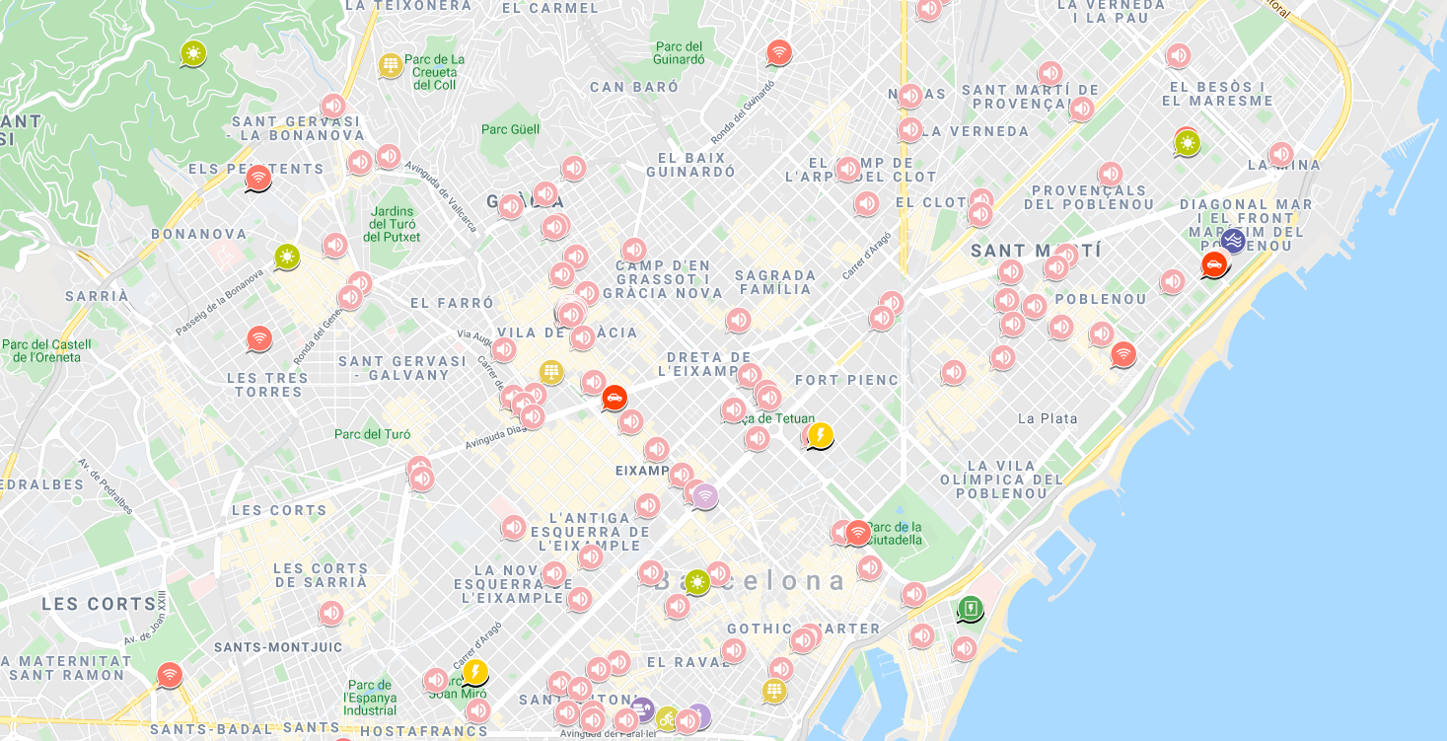
Available data
Bicing stations of the city of Barcelona
Cycle paths in the city of Barcelona
Bicycle lanes in construction in the city of Barcelona
Weather information
Sound sensors
Pollution data Barcelona
Bicing Statistics
API Streets and coordinates Barcelona
Street trees of the city of Barcelona

Slide 14
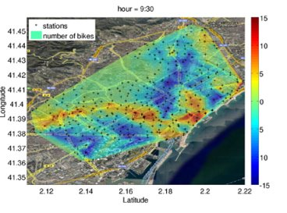
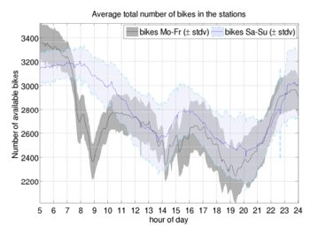
Available Data
[Possible first analysis with data already available]

Slide 15
Data [Nice to Have]
Bike path direction
Routes (starting point – destination – ending point)
Whole route data (not only start and ending point)
Detailed pollution index
Traffic lights

Slide 16

Project Plan
Foundation
Map of Barcelona as graph containing nodes and directions
First test of Djikstra shortest distance
Static Layer
Dangerous locations
Trees and green streets
Bike lines and 30 zones
Dynamic Layer – Real Time
Noise
Pollution
Traffic
Weather

Slide 17
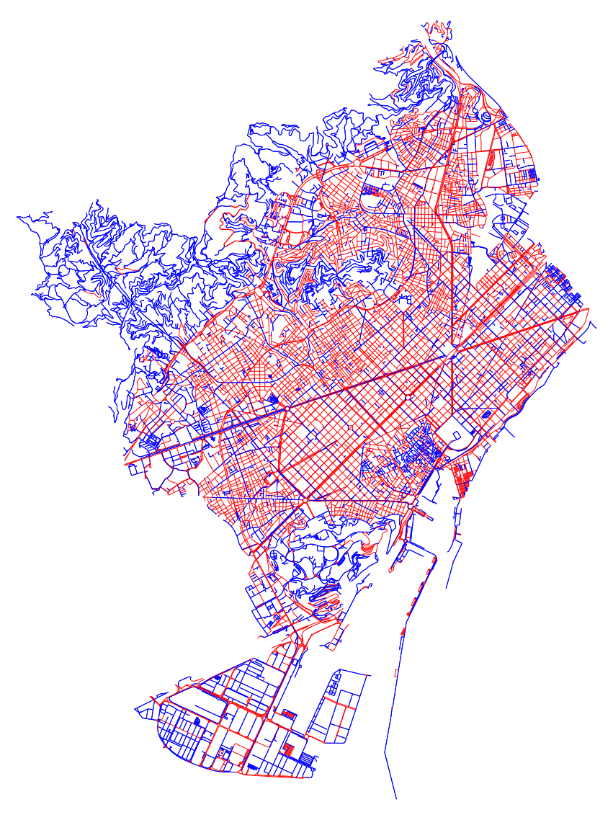
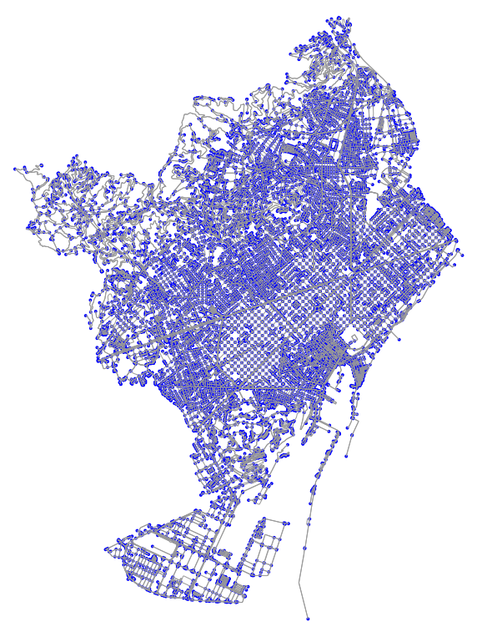
First layer – Foundation
Barcelona City Map with nodes
Barcelona City Map with directions

Slide 18
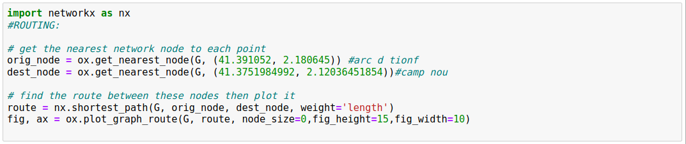
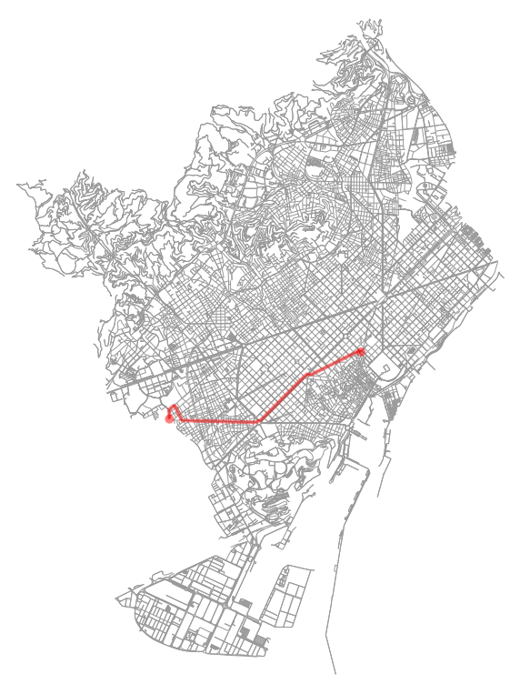
The Shortest Distance

Slide 19
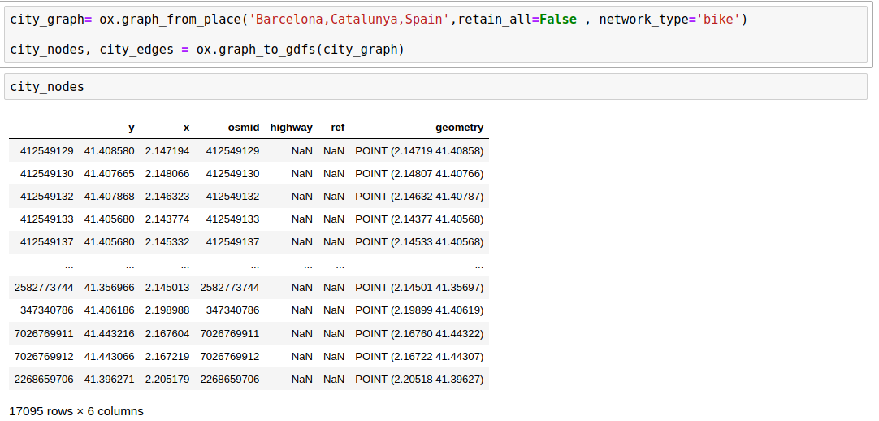
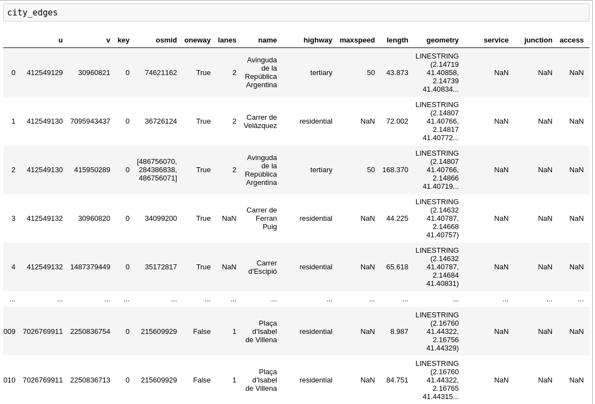
Nodes and Edges

Slide 20
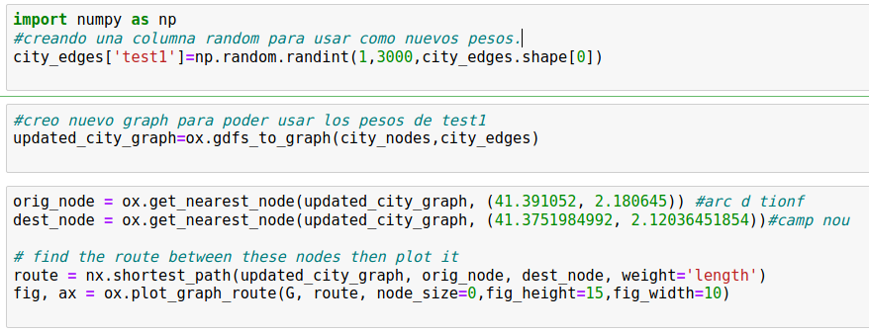
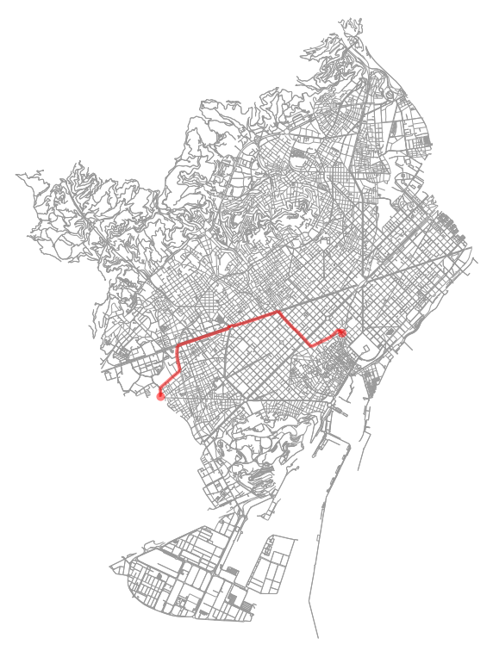
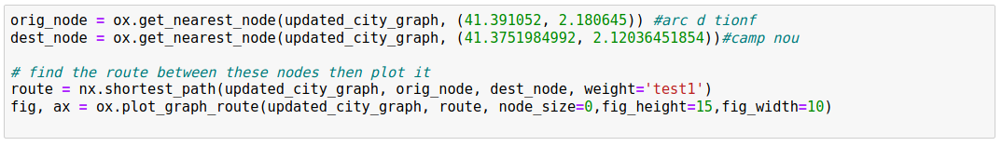
Test changing weights

Slide 21
Project Plan
Foundation
Map of Barcelona as graph containing nodes and directions
First test of Djikstra shortest distance
Static Layer
Dangerous locations
Trees and green streets
Bike lines and 30 zones
Dynamic Layer – Real Time
Noise
Pollution
Traffic
Weather

Slide 22
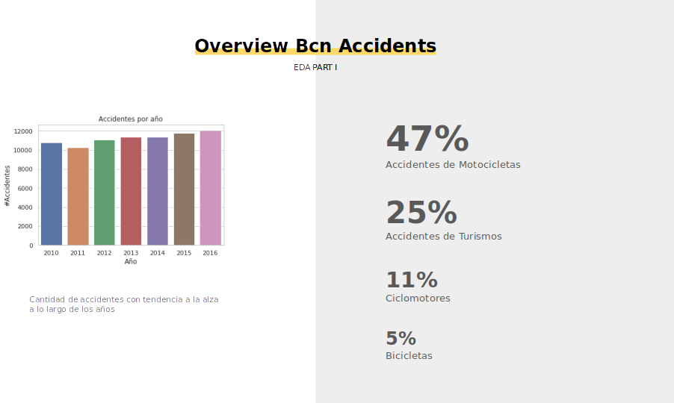

Slide 23
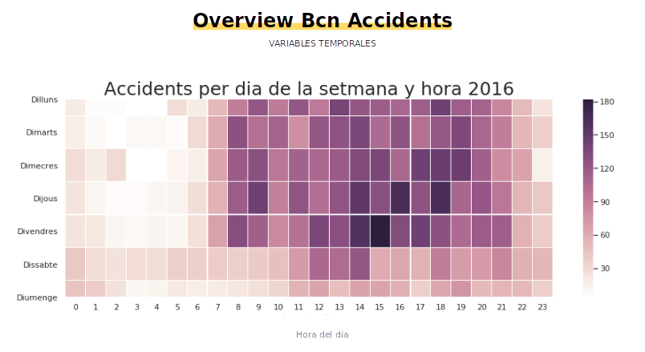

Slide 24
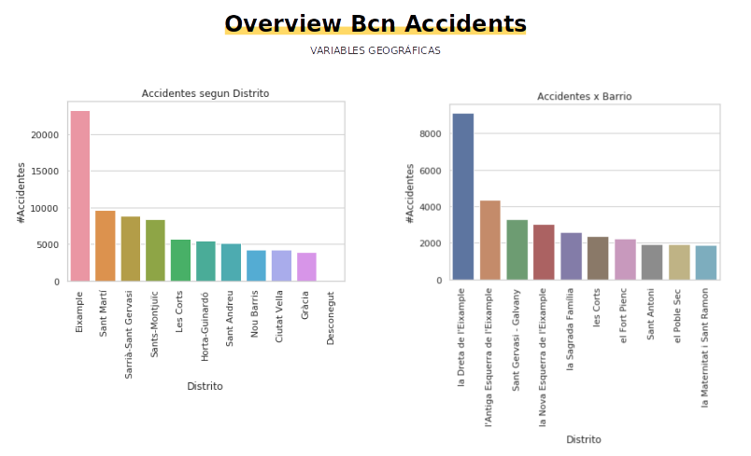
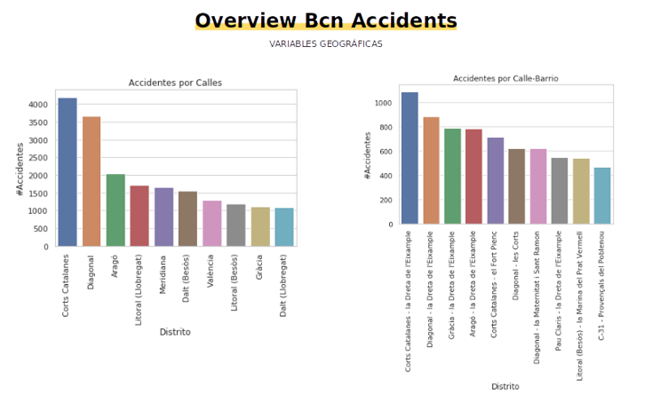

Slide 25
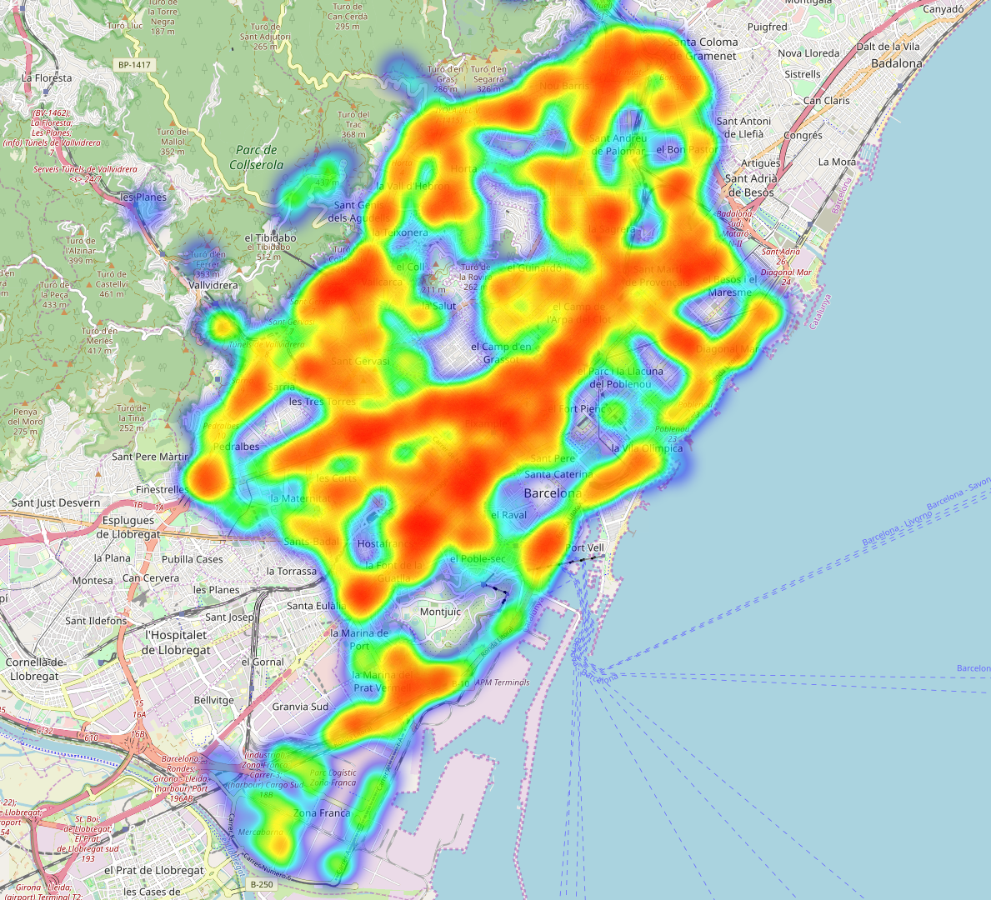
BCN Accidents 2016

Slide 26
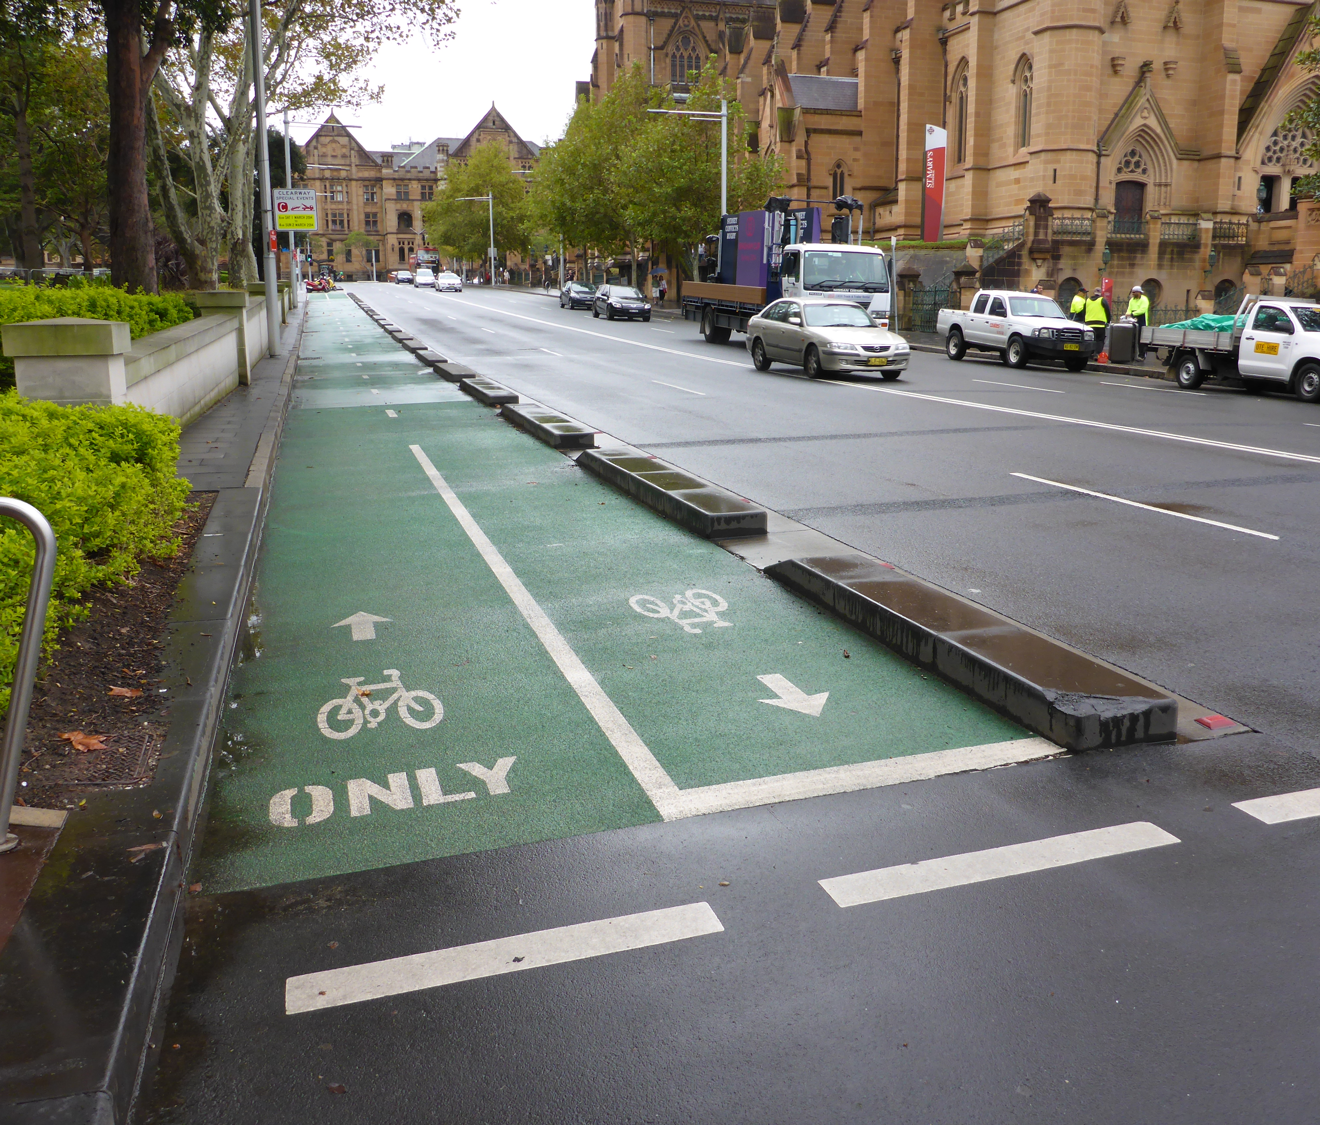
Solution
Creating a re-routing algorithm for bikers that:
Optimizes routes considering several individual preferences like time, traffic, pollution, temperature, noise
Recommends safer and healthier routes
Informs about street blockades and instructions
Offers information about bike stations and bikes itself
Add some other info about healthy life related with bikers or usual user routes
This Photo by Unknown author is licensed under CC BY-NC.

